Slide 1
E is for Execution
How to scale your business through flawless execution
mikebrcic.com

Slide 2
THE BIG QUESTIONS
What do we focus on?
How do we stay aligned?
How can we get s@#$ done?
How can we stop putting out fires?

Slide 3
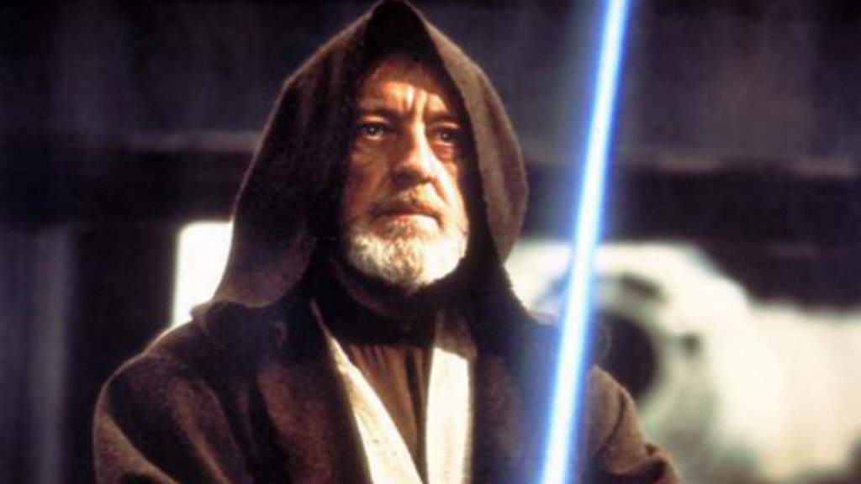
WHAT WE’LL COVER
01. EXECUTION MASTERY
03. THE POWER OF THE HUDDLE
02. PLAYBOOKS FOR THE WIN

Slide 4
01. Execution Mastery
A comprehensive system to help you and your team stay focused on what matters.

Slide 5
HOW DO WE STAY FOCUSED ON WHAT MATTERS?
“The main thing is to keep the main thing the main thing.”
-Steven Covey

Slide 6
…A SYSTEM ALSO TELLS YOU AND YOUR TEAM WHAT NOT TO DO
ONCE YOU’VE IDENTIFIED THE MAIN THING(S)…

Slide 7
LET’S TAKE A PEEK…

Slide 8
02. Playbooks
Outline your systems and procedures… and stop putting out fires!

Slide 9
WHAT’S A PLAYBOOK?
A system to help you organize the important procedures, documents and templates that outline the most important day-to-day activities of your business.

Slide 10
WHY DO I NEED A PLAYBOOK?
WITHOUT SYSTEMS, scale becomes extremely messy and labour-intensive.

Slide 11
LET’S TAKE A PEEK…

Slide 12
BONUS: Check out dashlane.com – and sign your team up!
DASHLANE.COM

Slide 13
03. Huddles
A regular rhythm for collaboration and cooperation

Slide 14
THE HUDDLES
Daily
Weekly
Monthly
Quarterly
Annual

Slide 15
Daily huddle
7 minutes total (ours is at 10:53 am)
Each core team member:
What I’m up to
Where I’m stuck/what I need
Regular alignment

Slide 16
Weekly huddle
90 minutes total
Good news (5 mins)
Core values (5 mins)
Customer/employee feedback (5 mins)
KPIs/metrics (15 minutes)
Goals/projects or Issues (55 mins, alternate)
Meeting close (5 mins)
Tuesdays work best (Monday is often a holiday or people are away, etc.)

Slide 17
Monthly huddle
60 minutes total
Operations/financial team*
Review previous month’s P&L, balance sheet, and cash flow
Review operating/business model
Review your financial performance
*and anyone else who is interested, depending on how open your company is

Slide 18
Quarterly huddle
Half day to full day
Review quarterly KPIs
Review previous quarter’s goals and projects
Map out new quarter’s goals/projects
Review company strategy and competitive landscape
Review marketing and sales strategy
Review Business Playbook
Where the rubber hits the road. These are crucial. Usually 1st Tuesday of new quarter.

Slide 19
LET’S RECAP

Slide 20
WHAT WE COVERED
01. EXECUTION MASTERY
02. PLAYBOOKS FOR THE WIN
03. THE POWER OF THE HUDDLE

Slide 21
GET: mikebrcic.com/execute (password ‘archangel’) CONNECT: facebook.com/mikebrcic

